Slide 1
COMP 918: Research Administration for Scientists
Introduction to Project
Management and Tools for Planning!
Tim Quigg, Lecturer and Associate Chair for Administration, Finance and Entrepreneurship Computer Science Department, UNC-Chapel Hill
© Copyright 2013 Timothy L. Quigg All Rights Reserved

Slide 2
Projects and Operations
A Project is a temporary endeavor with a defined beginning and end, undertaken to meet unique goals and objectives. The temporary nature of projects stands in contrast with…
Operations (business as usual) which are repetitive, permanent, or semi-permanent functional activities to produce products or services.
Think of individual grants as projects and the running of your lab or department as operations!

Slide 3
Projects and Operations
Because projects are focused activities with clear objectives and deadlines, the pace of activity is often high.
Operations are more routine and while deadlines apply, many things can wait till tomorrow.
Projects often require “special” resources, e.g., people with special skills (post doc, consultant, colleague from another field) for short periods.
Operations require people with a long term commitment to the organization and its mission!

Slide 4
Here’s the Challenge!
Most of us are (or will at times be) responsible for both operations and special projects!
We may even supervise people and resources that are involved in both!
The skills required to effectively manage operations and projects are quite different.
Today we’ll concentrate on the strategic approaches and the management skills applicable to managing projects!

Slide 5
Project Management
Project management is the discipline of planning, organizing, securing, and managing resources to achieve specific goals within a known time frame.

Slide 6
Three Basic Components of Any Project
Time – Budget - Scope
All three impact both the success and the quality of a project!
Project
Quality

Slide 7
Three Basic Components of Any Project
Time – Budget - Scope
And all three are inter-related - Changes in one will always impact the other two!
Project
Quality

Slide 8
Changes in Time – Project Duration
If the required completion date is “moved-up” (time is reduced), what might be the impact on scope and budget?
Scope: Might need to be reduced – less time means doing less work unless…
Budget: If scope can’t be reduced, then budget might need to be increased - more resources committed to meet the abbreviated schedule.
But that doesn’t always work! Sometimes “adding manpower to a late project only makes it later.”

Slide 9
Important Concepts in Project Management
Project Life Cycle
Control Concepts
Critical Path
Float Time

Slide 10
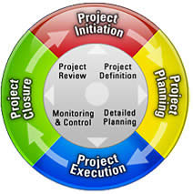
Four Phases of the Project Management Life Cycle
Definition/Initiation
Planning
Execution/Control
Closure
Think of them as four phases in an ongoing cycle, not as discrete linear activities!

Slide 11
Phase 1 - Definition/Initiation
Develop a Business Case
Undertake a Feasibility Study
Define Project Parameters
Appoint the Project Manager
Perform a Phase Review as part of the Project Review feeding into the institution’s Project Management System. Done at end of each phase!
So that future projects will benefit from this and all past experience!

Slide 12
Phase 2 - Planning Phase
Includes many important tasks, but the most important are:
the assembly of the Project Team
the development of a detailed Project Management Plan!
What should a project management plan include?

Slide 13
Project Management Plan
A project management plan should always cover the entire project end-to-end, from initiation through planning, execution and closure.
The suggested level of complexity depends upon then size and context of the project, but all management plans should include the following elements!
Overview: Purpose and primary objectives of the project.

Slide 14
Project Management Plan
A project management plan should always cover the entire project end-to-end, from initiation through planning, execution and closure.
The suggested level of complexity depends upon then size and context of the project, but all management plans should include the following elements!
Scope: Project needs, resource requirements, deliverables, constraints and breakdown of work structure.

Slide 15
Project Management Plan
A project management plan should always cover the entire project end-to-end, from initiation through planning, execution and closure.
The suggested level of complexity depends upon then size and context of the project, but all management plans should include the following elements!
Schedule: Detailed list of project activities and key milestones.

Slide 16
Project Management Plan
A project management plan should always cover the entire project end-to-end, from initiation through planning, execution and closure.
The suggested level of complexity depends upon then size and context of the project, but all management plans should include the following elements!
Costs: Project budget, funding sources and spending limits/constraints.

Slide 17
Project Management Plan
A project management plan should always cover the entire project end-to-end, from initiation through planning, execution and closure.
The suggested level of complexity depends upon then size and context of the project, but all management plans should include the following elements!
Quality: Metrics to determine success and system for tracking quality control.

Slide 18
Project Management Plan
A project management plan should always cover the entire project end-to-end, from initiation through planning, execution and closure.
The suggested level of complexity depends upon then size and context of the project, but all management plans should include the following elements!
Project Team: People working on project, their roles and responsibilities.

Slide 19
Project Management Plan
A project management plan should always cover the entire project end-to-end, from initiation through planning, execution and closure.
The suggested level of complexity depends upon then size and context of the project, but all management plans should include the following elements!
Communication and Decision-Making: Type, channels, levels of authority.

Slide 20
Project Management Plan
A project management plan should always cover the entire project end-to-end, from initiation through planning, execution and closure.
The suggested level of complexity depends upon then size and context of the project, but all management plans should include the following elements!
Risks: System to identify/evaluate risk and contingency planning.

Slide 21
Project Management Plan
A project management plan should always cover the entire project end-to-end, from initiation through planning, execution and closure.
The suggested level of complexity depends upon then size and context of the project, but all management plans should include the following elements!
Closure: Delivery and acceptance of deliverables, disassembling project team, disposition of resources .

Slide 22
Project Management Plan
A project management plan should always cover the entire project end-to-end, from initiation through planning, execution and closure.
The suggested level of complexity depends upon then size and context of the project, but all management plans should include the following elements!
Changes: Procedures for approving changes (authority) and for tracking cost, quality and other key components.

Slide 23
Phase 2 - Planning
Once all project activities are defined, large activities must be divided into smaller components (tasks) and then the following must be determined:
How are tasks inter-related?
Sequence of tasks?
Duration and “float” for each tasks?
Resource requirements to complete each task?
Authority/responsibility for each task?

Slide 24
Useful Planning Tools:
Fishbone Diagrams
Gantt Charts
Critical Path Flow Diagrams

Slide 25
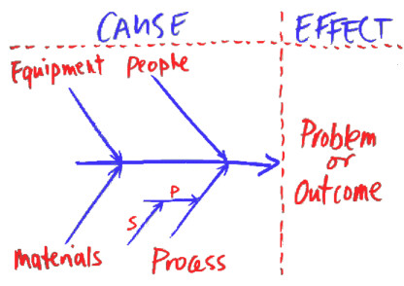
Fishbone Diagrams
A fishbone diagram has a central spine running from left to right, around which is built a map of factors which contribute to the final result or outcome. For each project the main categories of factors are identified and shown as the main 'bones' leading to the spine.

Slide 26
Fishbone Diagrams
Into each category can be drawn primary elements or factors (shown as P in the diagram), and into these can be drawn secondary elements or factors (shown as S). This is done for every category, and can be extended to third or fourth level factors if necessary.

Slide 27
Fishbone Diagrams
Fishbone diagrams are particularly useful in early project planning, notably when gathering and organizing factors that are required to complete a project and can be useful tools in identifying hidden factors. They are often the tangible result of “brainstorming sessions.”

Slide 28
Fishbone Diagrams
At a simple level, the fishbone diagram is a very effective planning and modeling tool - especially for mapping an entire operation. It can help identify the requirements of a project, but these diagrams aren’t detailed enough to help with scheduling issues.

Slide 29
Gantt Charts
Gantt charts are a type of bar chart used to illustrate a project’s schedule. They display the start and finish dates of the terminal elements and summary elements which comprise the work breakdown structure of a project. They are excellent tools for tracking/reporting/presenting both project plans and project progress easily and quickly.

Slide 30
Gantt Charts
The time-line for the duration of the project and every activity has a separate line. You can color code the time blocks to denote the type of activity, e.g., intense, watching brief, directly managed, delegated and left-to-run. You can schedule review and insert break points as needed. At the end of each line you can show as many cost columns for the activities as you need.

Slide 31
Gantt Charts
Gantt Charts are probably the most flexible and useful of all project management tools, but they do not easily or obviously show the importance and inter-dependence of related parallel activities. And they don't show the necessity to complete one task before another can begin, as a Critical Path Analysis will do.

Slide 32
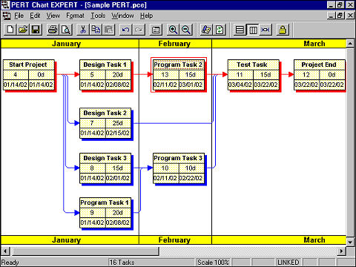
Critical Path Analysis
Critical Path Analysis flow diagrams are very good for showing interdependent factors whose timings overlap or coincide. They also enable a plan to be scheduled according to a timescale.
Note: Some tasks run concurrently, some must be completed before others can begin and some have extra “float time.”

Slide 33
Critical Path Analysis
Critical Path Analysis flow diagrams are very good for showing interdependent factors whose timings overlap or coincide. They also enable a plan to be scheduled according to a timescale.
Design Tasks 2 and 3 each require the same amount of time to complete, but 3 must be completed in one month, while 2 has two months available – it has one month of “float time.”

Slide 34
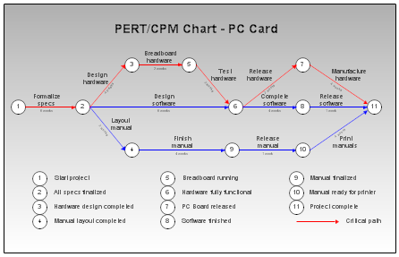
Critical Path Analysis – PERT
PERT (Program Evaluation and Review Technique) is a specialized method for identifying related and interdependent activities and events, especially in large projects that may contain hundreds or thousands of connected elements.
PERT is not normally used in simple projects, but for projects of considerable size and complexity (particularly when timing and interdependency issues are crucial), the Project can benefit from the detailed analysis enabled by PERT.

Slide 35
Phase 3 - Execution with Controls
Project Manager must have near total control over all aspects of project. He/she assigns resources/budget to tasks and assigns tasks to Project Team members.
The work of the project begins!
Goal is to keep the project on-track, on-time, within budget and within quality and risk parameters!

Slide 36
Phase 3 - Execution with Controls
Project Manager must implement appropriate control systems to track performance against budget to monitor:
Time – Is project on-time?
Cost – Is project within budget?
Quality – Is the quality within standards?
Change – What impact have changes had on time, cost, scope and quality?
Risk – Is project within established risk parameters?

Slide 37
Phase 3 - Execution with Controls
Determine the points of greatest risk, e.g., tasks on the critical path.
Exercise tighter control on these tasks and less control on tasks with greater time float and budget flexibility.
Note: As float time is expended, tasks may move onto the Critical Path!

Slide 38
Phase 4 - Closure
Deliverables, approval/acceptance by customer
Budget accounting
Legal – permits, approvals, occupancy
Reassignment of staff and residual resources
Document process

Slide 39
Case Study: Woody’s Custom Woodworking
Woody’s Custom Woodworking Company is a small-to-medium sized custom furniture and cabinet-making company. It’s product line includes attractively designed and well constructed custom furniture to order, using imported hardwoods and indigenous softwoods. Woody's also produces, several lines of furniture for the wholesale/retail market, and a number of variations of standard kitchen and bathroom cabinets, including units made to order. The company has recently moved into subcontract work supplying and installing counter-tops, cabinets and similar fixtures for new commercial construction. To date, Woody's has established a well-founded reputation for supplying millwork to the construction industry.

Slide 40
Phase 1 - Definition/Initiation
Develop a Business Case – Explain/critique the case for the Woody 2000 Project?
Undertake a Feasibility Study - How well was it conceived and executed? What improvements would you suggest?
Define Project Parameters – Were they sufficiently defined?. Why was the renovation of executive offices added to the project?
Appoint the Project Manager – Who was it?
Was Leadbetter a good choice?

Slide 41
Phase 2 – Planning Project Management Plan
Overview: Purpose and primary objectives.
Scope: Project needs, requirements, deliverables, constraints, and work breakdown structure.
Schedule: Detailed list of project activities and key milestones.
Costs: Project budget, sources and spending limits/constraints.
Quality: Metrics to determine success and system for tracking quality control.

Slide 42
Project Management Plan
Project Team: People working on project, their roles and responsibilities.
Communication and Decision-making: Type, channels, levels of authority.
Risks: System to identify/evaluate risk and contingency planning.
Closure: Delivery and acceptance of deliverables, disassembling project team, disposition of resources.
Changes: Procedures for approving changes (authority) and for tracking cost, quality and other key components.

Slide 43
Project Management Plan
Was the Project Management Plan adequate? What improvements would you suggest?
The budget was set at $17 million. Was a rational process followed?
Moneyworth did not involve the production staff in the planning process. Your opinion?
He sought a “fixed price” quote from EID. Was this wise? What problems did it create?

Slide 44
Project Management Plan
Critique the issues surrounding the development of Cashman’s monthly cash flow chart.
Faster decided to change the production train specification. Were the rules for making project modifications clear? What problems did this decision create?
What plans were made for project closure, e.g., inspection and acceptance of building, testing of production train?

Slide 45
Phase 3 - Execution with Controls
Project Manager must implement appropriate control systems to track performance against budget to monitor:
Time – Is project on-time?
Cost – Is project within budget?
Quality – Is the quality within standards?
Change – What impact have changes had on time, cost, scope and quality?
Risk – Is project within established risk parameters?

Slide 46
Phase 4 - Closure
Deliverables, approval/acceptance by customer
Budget accounting
Legal – permits, approvals, occupancy
Reassignment of staff and residual resources
Document process

